Slide 1


Lecture 3 Higher Order Functions
28.3.2023
Iflaah Salman

Slide 2
Higher Order Function (HOF)
Functions are values.
Functions in Scala are part of the type system.
just as a parameter can be of type Int, Boolean or Person, a parameter to a method or a function can be another function.
A function that takes a function as a parameter
is referred to as a higher-order function.
HOFs are functions that do at least one of the following:
Take as a parameter one or more functions.
Return as output a function

Slide 3
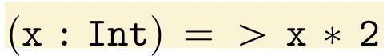
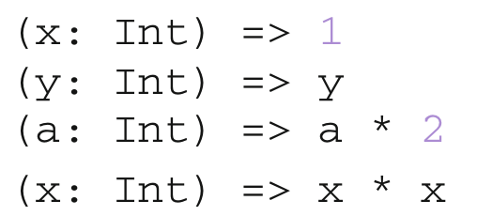
Scala Higher Order Functions
A function definition defines a function type.
A type that takes zero or a set of parameters (of given types) and returns a result.
It is a one parameter function that takes
an Int and returns an Int— that is its type.
Thus a parameter that expects to be given a reference to a function that takes an int and returns an Int can be given a reference to any function that takes an Int and returns an Int.
Notes:
The function can have any definition except that it takes an int and returns an int when passed as a parameter to another function or method.

Slide 4
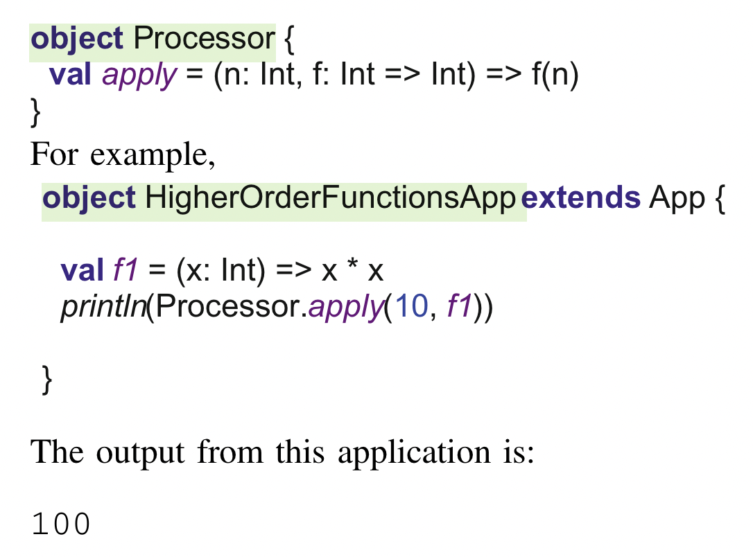
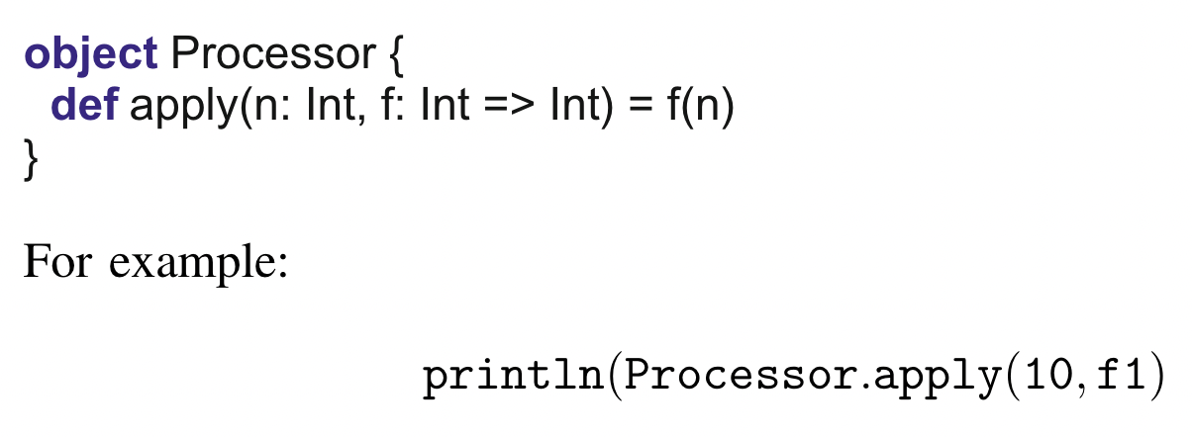
Scala Higher Order Functions
The concept of HOF also applies to methods.
The function apply is a higher-order function because its behaviour (and its result) will depend on the behaviour defined by another function—the one passed into it.

Slide 5
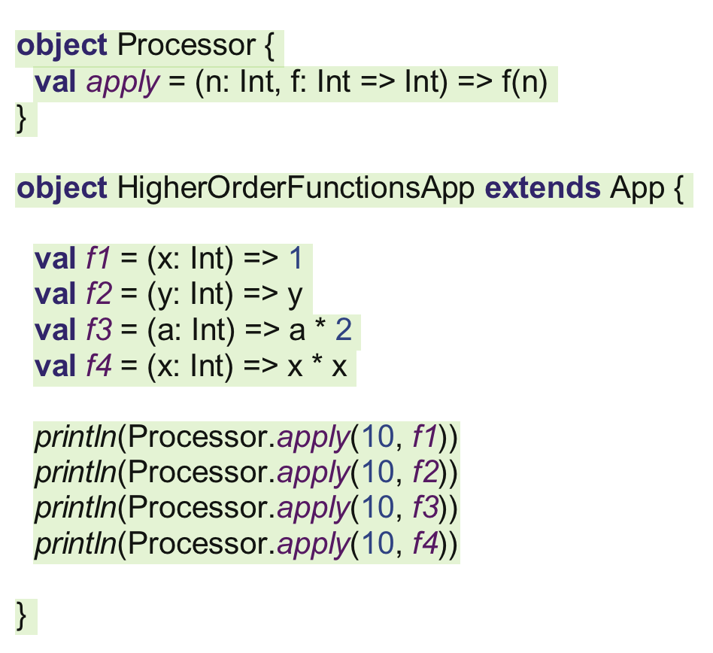
Scala HOF!
Notes:
Scala is smart enough to know the return type. But for good coding practices, one should explicitly mention it.

Slide 6
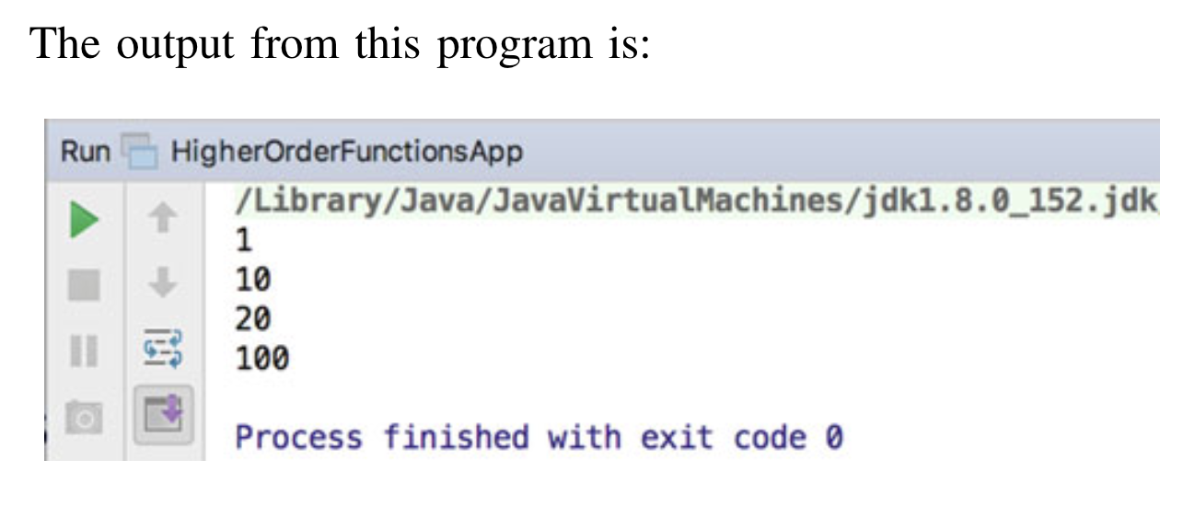
Scala HOF
Notes:
Scala is smart enough to know the return type. But for good coding practices, one should explicitly mention it.

Slide 7
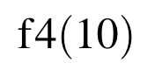

Why to use Higher Order Functions?
We could have called one of the functions (f1 to f4) directly by passing in the integer to be used.
The key is:
We may know that some function should be applied to the value 10 but we do not yet know what it could be.
we are creating a reusable piece of code
The piece of code that will apply an appropriate function to the data (we have) when that function is known.
Same result as the following

Slide 8
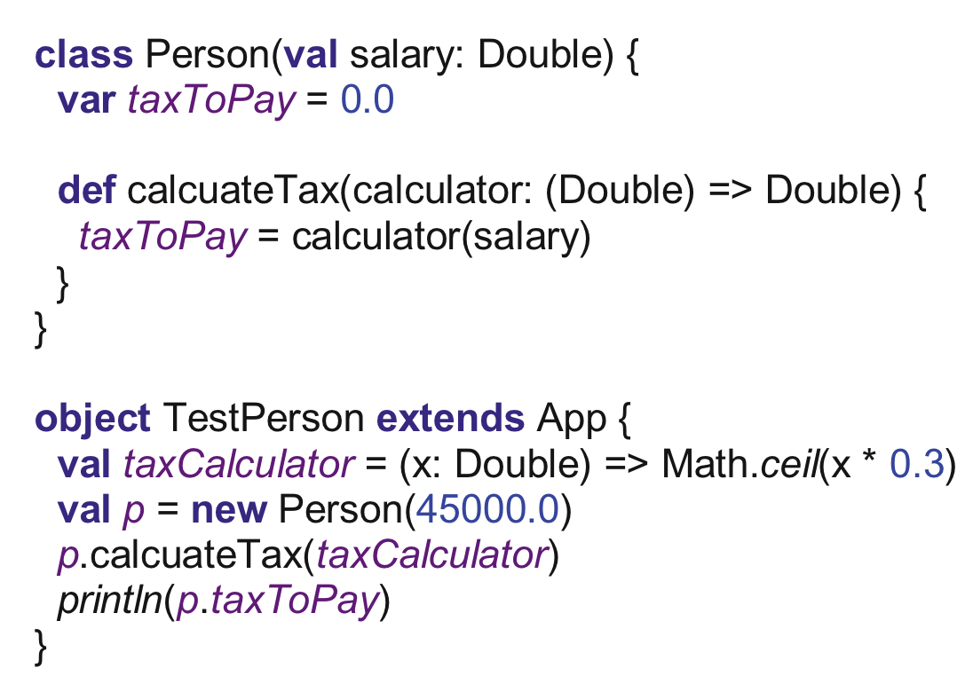
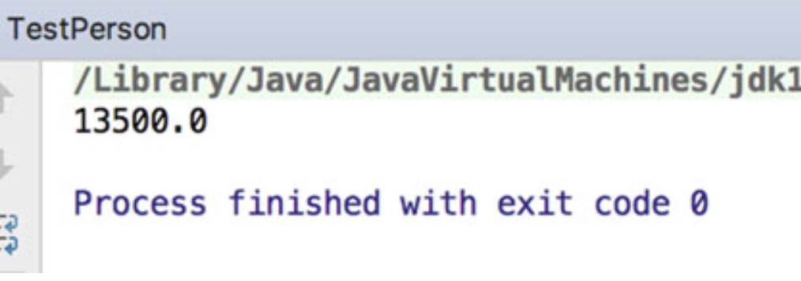
Higher Order Functions Scenario
Person class has a salary property. But, we do not know how to calculate the tax because it is dependent on external factors.
calculateTax method could take an appropriate function that performs that calculation and provides the tax value.
class Person itself does not have a way of calculating the tax
taxCalculator val variable contains a reference to a function.
The calculateTax method is called by passing in the taxCalculator function.
Thus the class person is a reusable class that can have different tax calculation strategies defined for it.

Slide 9
Higher Order Functions in Scala Collections
The filter method and the foreach method – the two most popular HOFs used with Scala collection classes (Class List).
The parameter to filter method is a type of function that takes a single parameter and returns a Boolean. The whole method itself return a new List.
‘A’ is a placeholder for the type held by the List.
The function p is used to test all the elements in the List. Those that return true are included in the list of values returned.
The foreach method applies a function ‘f’ to all elements of the list in turn.
Any result generated by the function ‘f’ is discarded.

Slide 10
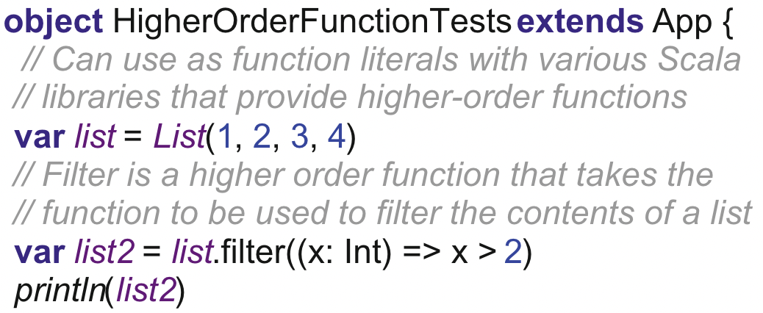
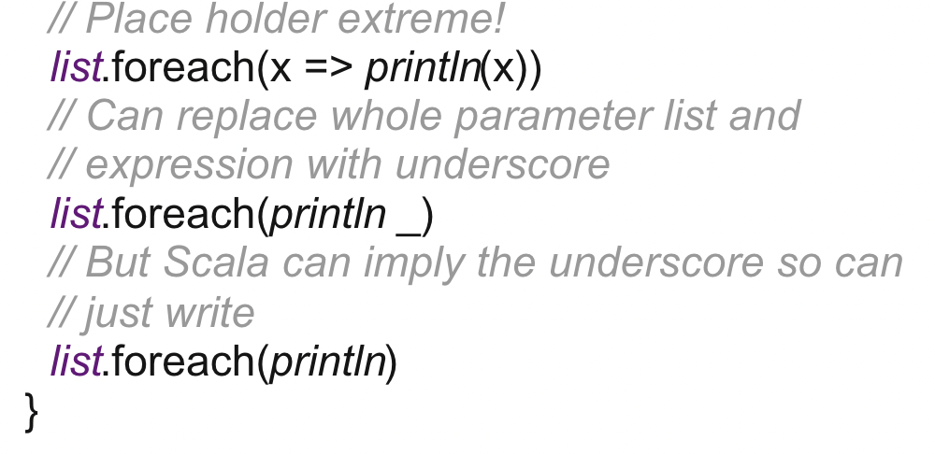
Higher Order Functions in Scala Collections

Slide 11
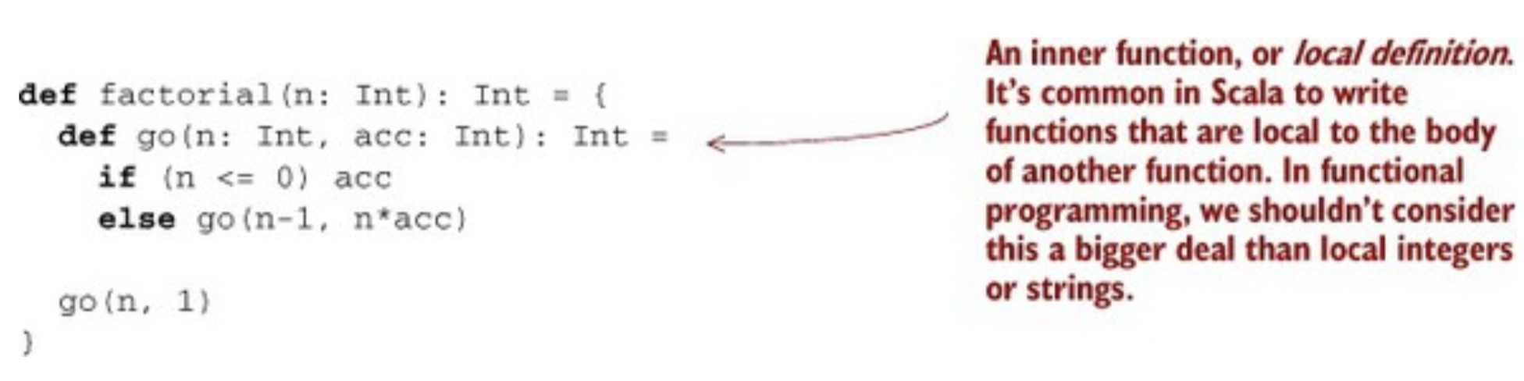
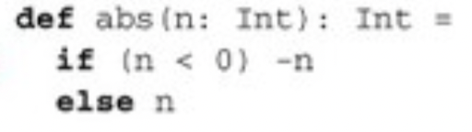
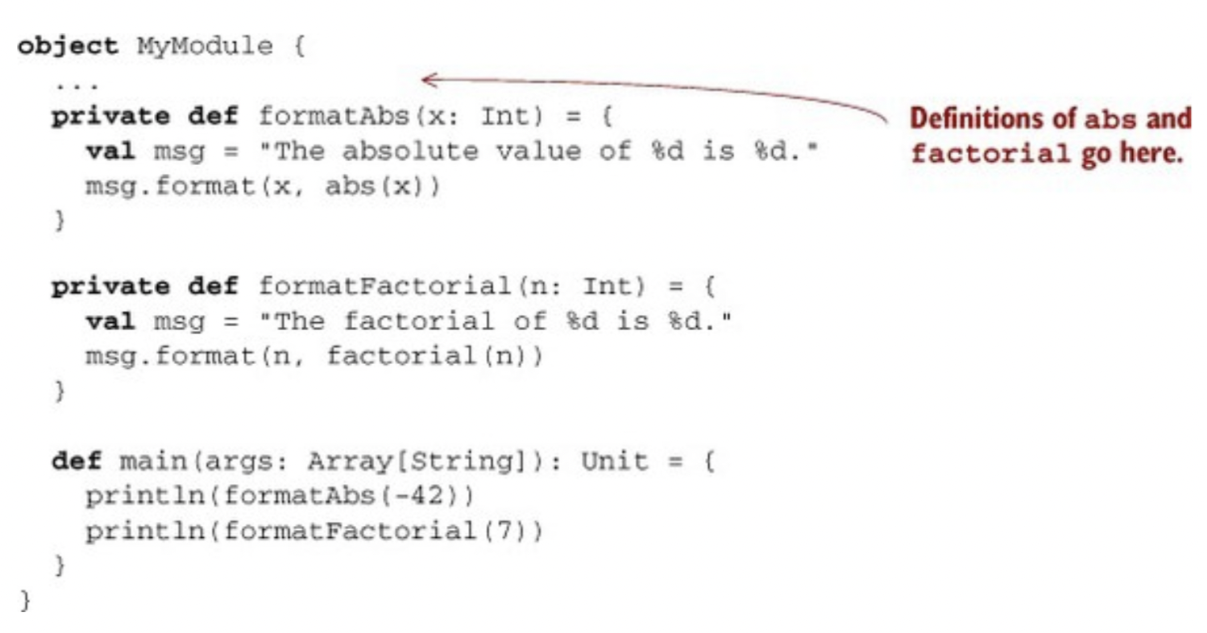
Higher Order Functions

Slide 12
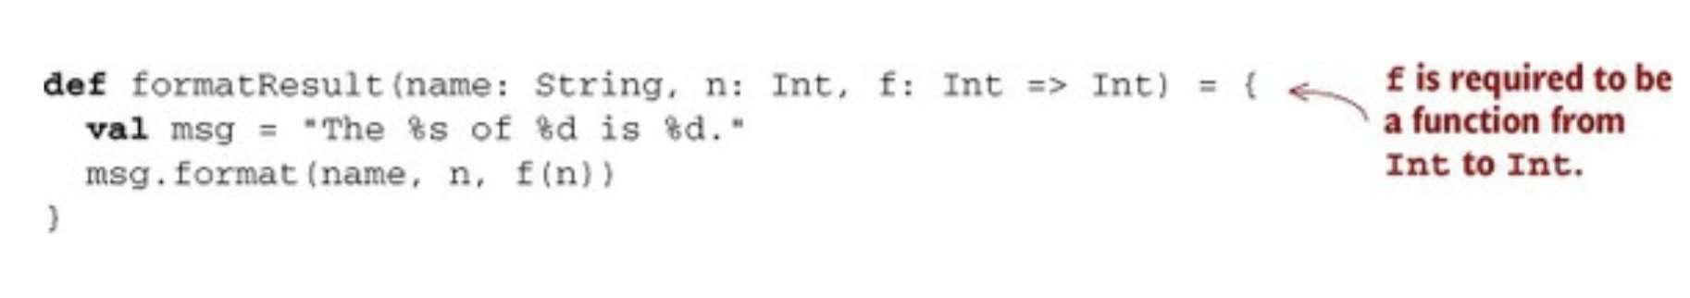
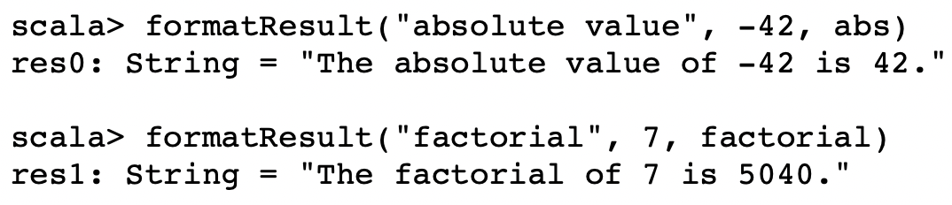
Higher Order Functions
The two functions, formatAbs and formatFactorial, are almost identical. If we like, we can generalize these to a single function, formatResult, which accepts as an argument the function to apply to its argument
abs accepts an Int and returns an Int. And likewise,
factorial accepts an Int and returns an Int,
Both match the Int => Int type.
We can therefore pass abs or factorial as the f argument to formatResult.

Slide 13
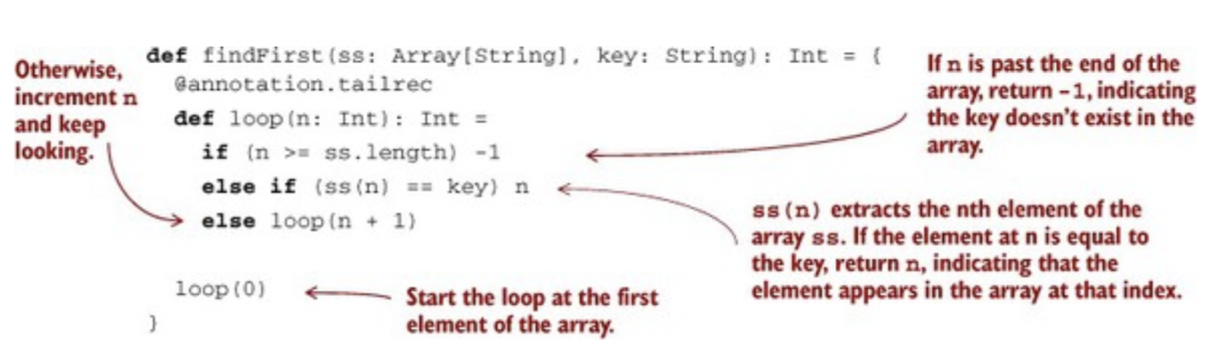
Polymorphic Functions
Functions that operate on only one type of data are called monomorphic functions, e.g., formatResult method; Int => Int
HOF that works for any type it’s given is called a polymorphic function.
Polymorphic functions are also called generic functions.
Monomorphic function:

Slide 14
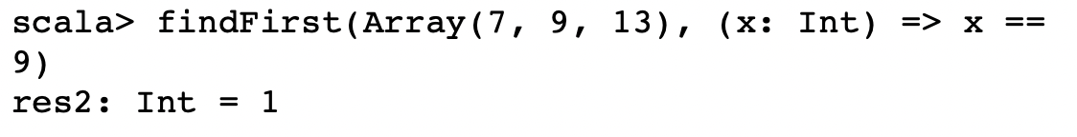
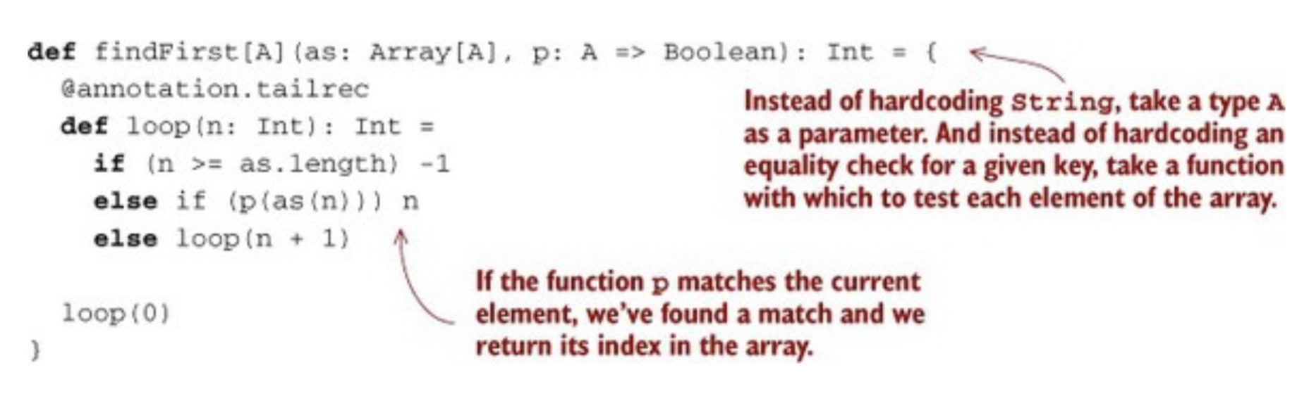
Polymorphic Functions
We’re abstracting over the type of the array and the function used for searching it.
we introduce a comma-separated list of type parameters, surrounded by square brackets (here, just a single [A])
The type parameter list introduces type variables that can be referenced in the rest of the type signature (similar to parameters in the argument list that are used in the function body).
The fact that the same type variable is referenced in both places in the type signature implies that the type must be the same for both arguments
Notes:
The syntax (x: Int) => x == 9 is a function literal or anonymous function.

Slide 15

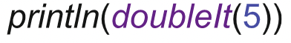

Partially Applied Functions
A Partially Applied function is a function where one or more of its parameters have been applied or bound to a value, creating a new function with one fewer parameter than the original.
Now we bind the first parameter to 2 so that it will always double the second parameter and store the resulting function reference into a property double.
This allows for overloading of functions.
overloading relates to functions with the same names but different parameter types.
doubleIt now references a function that takes one parameter an Int.
The ‘_’ underbar indicates a placeholder for future values, and the type that will be used with this placeholder is Int.

Slide 16
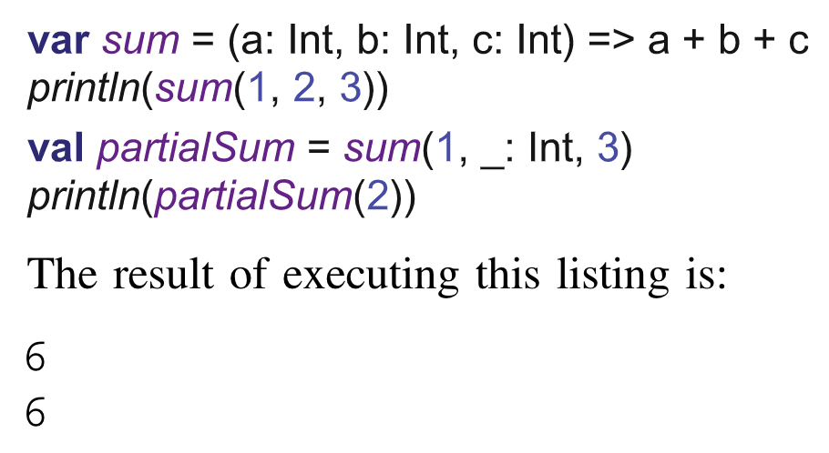
Partially Applied Functions
It is also possible to have more than one parameter bound and more than one parameter left unbound.
These parameters can be intermixed with any parameter in any position being bound or unbound as required.
Partially applied functions are useful for creating new functions from existing functions.

Slide 17
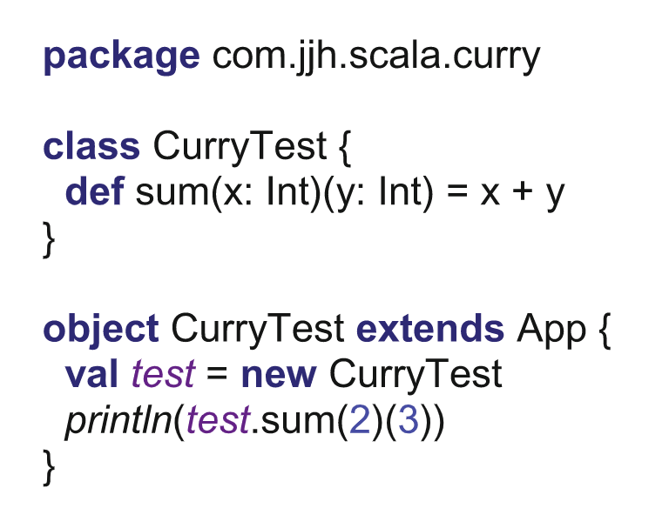
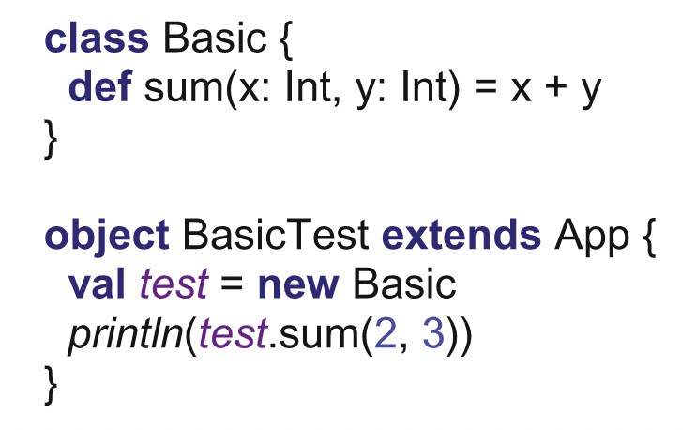
Currying
It is an alternative approach to Partially Applied functions.
A curried function is a function that is applied to multiple argument lists (in contrast a Partially Applied function has one argument list).
Note that functions can have one or more parameter lists.
a single argument list with
multiple parameters.
The same function as a multiple argument function, in which each argument list takes a single argument/parameter.
Notes:
The arguments can still be used in the body of the function (and thus we can still add x and y).

Slide 18
Currying
This version results in two function invocations back to back.
It is a bit like chaining two functions together.
The first function invocation takes a single Int parameter x and returns a function value for the second function.
The second function takes the Int parameter Y and applies it to the first function’s result.

Slide 19
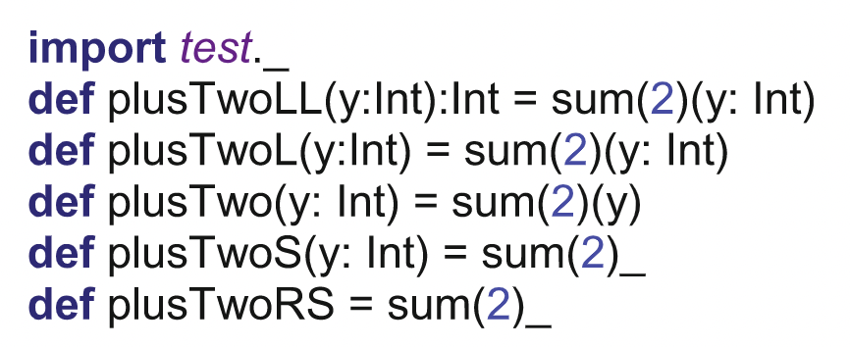
Using Curried Functions
These are all variations on the definition of the curried function.
Partially Applied functions are more flexible in terms of which parameters are applied/bound and which are not yet applied/bound.

Slide 20
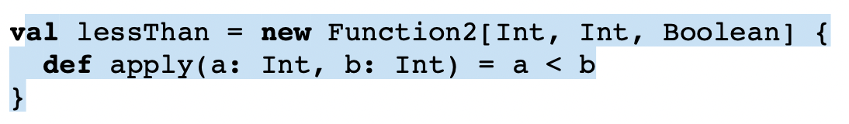
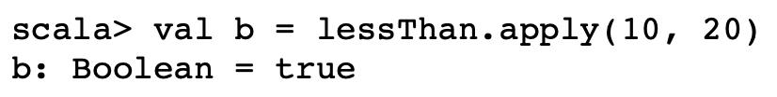
Function Literals
When we define a function literal, what is actually being defined in Scala is an object with a method called apply.
(a, b) => a < b This is syntactic sugar for the following object creation:
Function2[Int, Int, Boolean] is usually written (Int, Int) => Boolean.
the Function2 interface (known in Scala as a trait) has an apply method.
Function2 is just an ordinary trait (an interface) provided by the standard Scala library to represent function objects that take two arguments.
The library also provides Function1, Function3,… Function X, taking a number of arguments indicated by the name (In Scala X can maximum be 22).

Slide 21

References
Chiusano, P., & Bjarnason, R. (2014). Functional Programming in Scala. Manning publications.
Hunt, J. (2018). A Beginner’s Guide to Scala, Object Orientation and Functional Programming. In A Beginner’s Guide to Scala, Object Orientation and Functional Programming. Springer International Publishing. https://doi.org/10.1007/978-3-319-75771-1

